Slide 1
Eazy Park
Made By:
Vandit Gupta
Akshit Diwan
Karan Garg

Slide 2
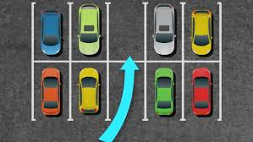
Introduction
Eazy Park helps you to find the nearest parking slot for your car easily and in real-time.
In this project, we use object detection technology using Masked R-CNN and find which spot is available for your car(parked car boxes) by comparing the pixel values of the intersection of two cars upon total pixel values (IoU).

Slide 3
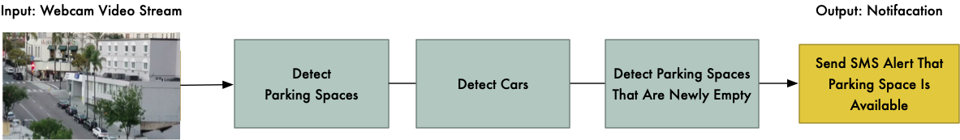
Steps involved:
Detecting parking spaces in an image.
Detecting cars in one frame.
Detecting parking slots which are empty.

Slide 4
Mask- RCNN
We use a newer deep learning approach like Mask R-CNN, Faster R-CNN or YOLO that combines the accuracy of CNNs with clever design and efficiency tricks that greatly speed up the detection process.
R-CNN: Bounding boxes are proposed by the “selective search” algorithm, each of which is stretched and features are extracted via a deep convolutional neural network, such as Alex Net, before a final set of object classifications are made with linear SVMs.
Fast R-CNN: Simplified design with a single model, bounding boxes are still specified as input, but a region-of-interest pooling layer is used after the deep CNN to consolidate regions and the model predicts both class labels and regions of interest directly.
Faster R-CNN: Addition of a Region Proposal Network that interprets features extracted from the deep CNN and learns to propose regions-of-interest directly.
Mask R-CNN: Extension of Faster R-CNN that adds an output model for predicting a mask for each detected object.

Slide 5
COCO dataset:
We use COCO(Common Objects in Context) dataset in our project for the purpose of object detection.
COCO is a large-scale object detection, segmentation, and captioning dataset. COCO has several features:
Object segmentation
Recognition in context
Superpixel stuff segmentation
330K images (>200K labeled)
1.5 million object instances
80 object categories(like cars,bus,bike,person,etc.)
91 stuff categories
5 captions per image
250,000 people with keypoints

Slide 6
For each object detected in the image, we get back four things from the Mask R-CNN model:
The type of object that was detected (as an integer). The pre-trained COCO model knows how to detect 80 different common objects like cars and trucks. Here is a full list of them.
A confidence score of the object detection. The higher the number, the more certain the model is that it correctly identified the object.
The bounding box of the object in the image, given as X/Y pixel locations.
A bitmap “mask” that tells which pixels within the bounding box are part of the object and which aren’t. With the mask data, we can also work out the outline of the object.

Slide 7
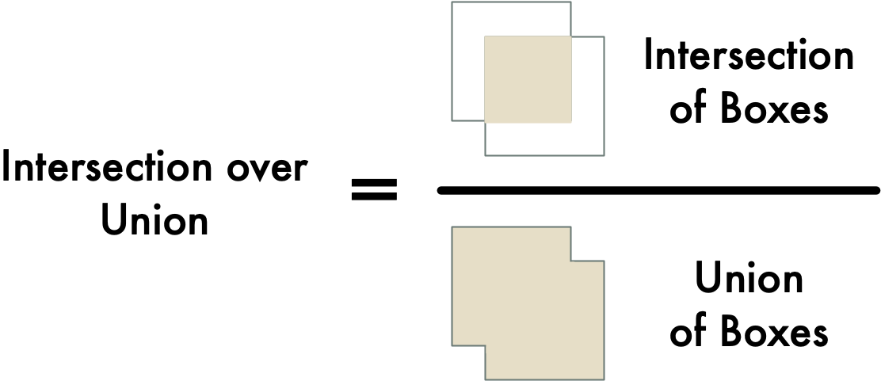
IoU(Intersection Over Union)
This will give us a measure of how much a car’s bounding box is overlapping a parking spot’s bounding box. With this, we can easily work out if a car is in a parking space or not. If the IoU measure is low, like 0.10, that means the car isn’t really occupying much of the parking space. But if the measure is high, like 0.6, that means the car is occupying the majority of the parking space area so we can be sure that the space is occupied.

Slide 8
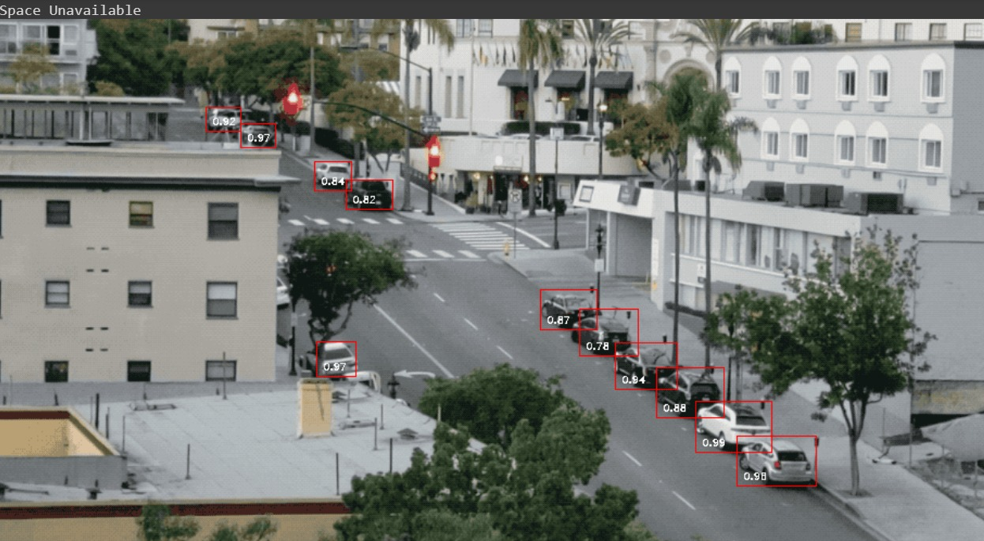
OUTPUT (INITIAL)

Slide 9
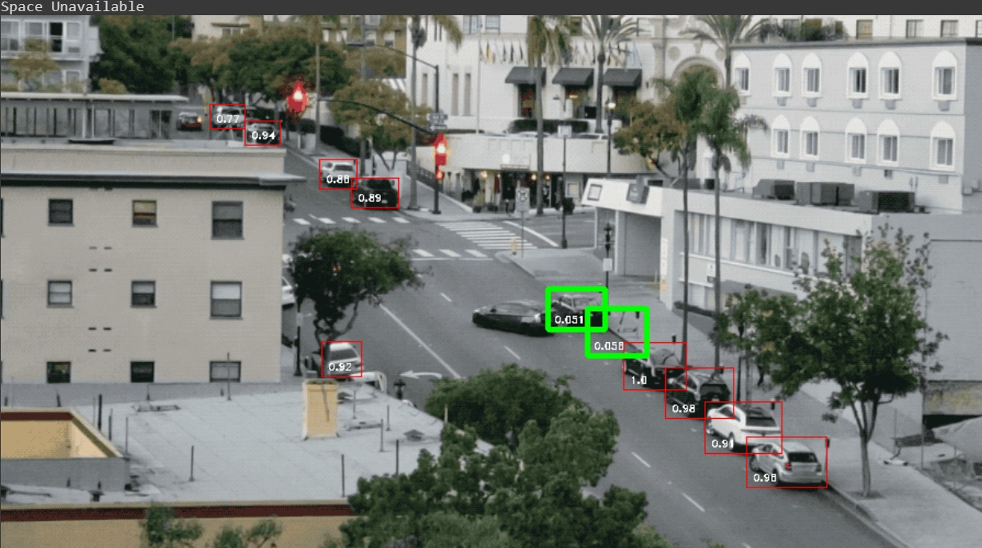
OUTPUT (FINAL)

Slide 10
THANK YOU

